Slide 1

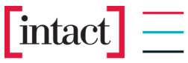
Intact Insurance Specialty Solutions Access Management for Infrastructure Resources in the Azure Cloud
Making the Future Together
April 9, 2021

Slide 2
Introduction to Key Access Management Concepts in the Azure Cloud
Azure Resource Manager (ARM) [link] is the deployment and management service for Azure. It provides a con-sistent management layer that enables you to create, update, and delete resources in your Azure subscription. You can use its access control, auditing, and tagging features to secure and organize your resources after deployment.
Azure Role-based Access Control (RBAC) [link] is a system that provides fine-grained access management of Azure resources. Using RBAC, you can segregate duties within your team and grant only the amount of access to users that they need to perform their jobs.
With Azure Active Directory (AAD) Privileged Identity Management (PIM) [link], you can manage, control, and monitor access within your organization. This scope includes access to Azure resources, Azure AD and other Microsoft online services like Office 365 or Microsoft Intune.
Azure Policy [link] is a service in Azure that you use to create, assign, and manage policies. These policies en-force different rules and effects over your resources, so those resources stay compliant with your corporate standards and service level agreements.

Slide 3
The «Why»: Key Drivers for this Concept
For Intact Security, we need to define Intact USA-specific «User Entity Controls» to complement Microsoft’s SOC-2 infrastructure controls in the Azure Cloud.
Intact USA is moving towards Azure cloud and we like to implement the Security Governance
implementation of proper access management controls in Azure cloud subscriptions:
Proliferation of individual/warm body role assignments (ownership and privileged access to resources)
B2B guests hold (direct) role assignments to Azure resources
Lack of risk-based 4-eye principle implementation, recertification and joiner-mover-leaver processes
Limited usage of audit logs for monitoring of key access controls

Slide 4
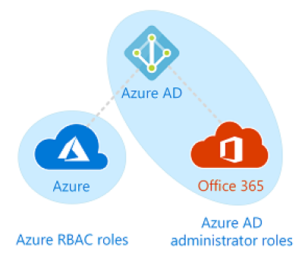
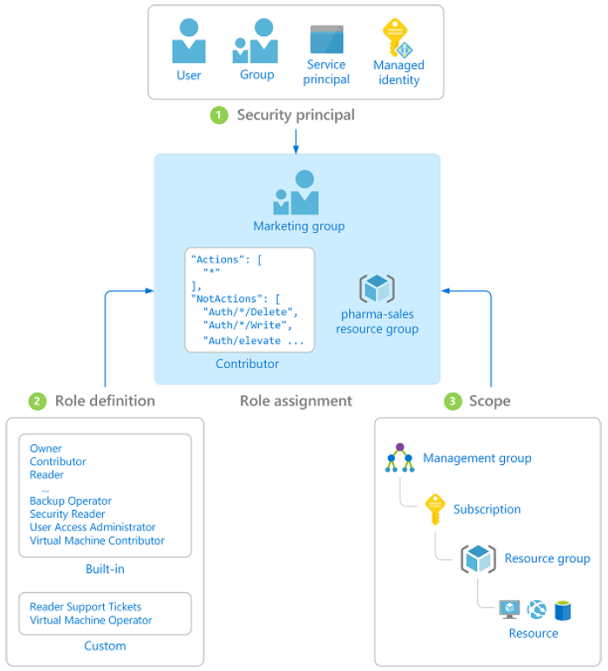
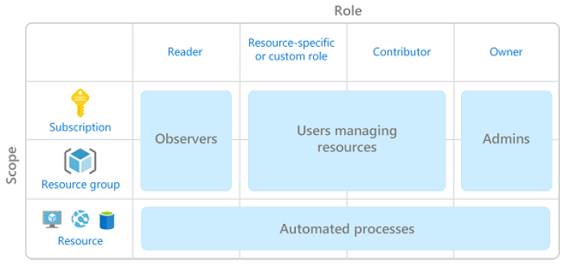
The «What»: Scope of this Access Management Concept
RBAC roles of the Azure Resource Manager (ARM) which are needed for the management of the various infrastructure & platform re-sources in Azure (i.e. management groups, subscriptions, resource groups and resources).
in scope

Slide 5
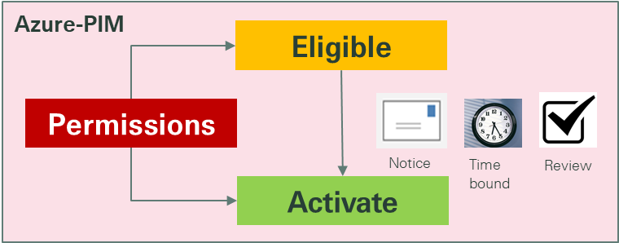
The «How»: Guiding Principles
Strive for as much flexibility as possible for the Business Domains while complying with all the required access management controls
Leverage the built-in security services of Azure (especially the capabilities of the Privileged Identity Manager [PIM] in Azure Active Directory, please see below) and follow Microsoft’s security recommendations:
Use Intact (USA)-established IAM processes and controls wherever the Azure capabilities fall short of expectations:
Creation of security groups in Azure AD with normal application owner permissions
Mover & leaver processes
4-eye principle for highly critical & privileged role assignments

Slide 6




The «How»: General Azure-centric Access Management Approach
2. Assign team mem-bers to the groups.
1. Create functional groups for your development team in Azure AD.
3. Assign RBAC / Azure DevOps roles to the functional groups (in ARM, DevOps or PIM).
Owner Group
Normal RBAC role assignments in the Azure Resource Mgr
User Access Manager Group
uncritical roles
Infrastructure Engineer Group
Application Developer Group
critical & privileged roles
Sensitive / privileged role assignments in Azure PIM
Tester Group
Operations Group

Slide 7
Access Management Controls in the First Implementation Approach
1. Manage functional groups as re-gular access products in SailPoint with the classical IAM setup.
1. Creating IAM-managed access products establishes the integration with our fully audited IAM ordering process and provisions the required security Groups in Azure AD
2. Manage group memberships as classical IAM entitlements.
2a. IAM-managed group memberships ensure compliant approval and recertifica-tion processes (LM endorsement as well as 2-eye or 4-eye approvals) and inte-gration with the established mover & leaver processes.
2b. Furthermore, IAM-managed group memberships avoid the governance con-cerns which are associated with B2B guest accounts.
3. Manage role activation and role assignment recertification of critical & privileged roles directly in Azure PIM.
3a. Using Microsoft’s fine-grained RBAC model in ARM and PIM enables a proper im-plementation of the least privilege principle.
3b. Azure PIM provides modern Privileged Access Management capabilities and a complete audit trail of all access management relevant role assignments to the security groups in Azure AD.

Slide 8
The Functional Group Design is Flexible
Please note that direct role assignments to users will be prohibited by a policy.
<APP_ID>_<SecZone>_Owner
These two groups are pre-provisioned as privi-leged access products when a subscription is created. The Owner and the User Access Ad-ministrator roles will be automatically assigned to the groups and the subscription in PIM.
<APP_ID>_<SecZone>_UserAccAdmin
<APP_ID>_<SecZone>_Group_1
<APP_ID>_<SecZone>_Group_2
This list of functional groups is not pre-determined and can be chosen by the application owners.
<APP_ID>_<SecZone>_...
<APP_ID>_<SecZone>_...
<APP_ID>_<SecZone>_Group_N

Slide 9
The «When»: Next Steps and High Level Implementation Plan
Activity | Timeline
Verify and document the proposed concept. Reconfirm the availability of the necessary licenses for PIM (EMS E5 / AAD Premium P2). Engage with the business and the IT domains to gain their buy-in for the proposed concept. Document concrete guidelines for the Access Management of Azure Infrastructure Resources. | Q3 2021
Define and implement the basic compliance policies at management group level. Default role assignments only via pre-defined security groups (owner, user access admin) No role assignments to individual users/warm bodies No ownership assignments to B2B guests Extend the APP subscription ordering process to introduce the automated provisioning of the default security groups (incl. their access products) and the PIM role assignments for these groups. Communicate the new access management regime and activate the basic compliance policies in auditing mode. | Q4 2021
Support the domains with the necessary access management clean up in all existing subscriptions. Switch the basic compliance policies to enforcement mode once the clean up in a management group has been accomplished. | Q1 2022

